Slide 1
Potential Risks, Ethics and Regulations
Notes:
Good morning! Today I am going to talk about a software program recently developed by me and my colleagues, PEAKS, for de novo sequencing and protein identification.

Slide 2
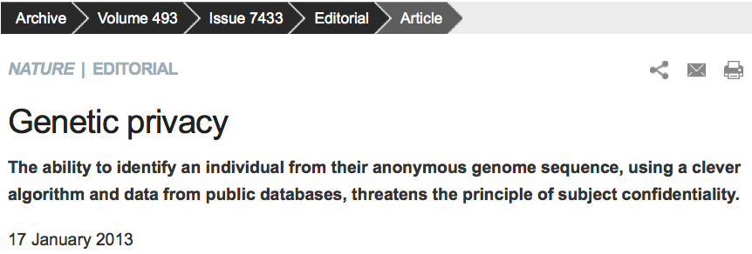
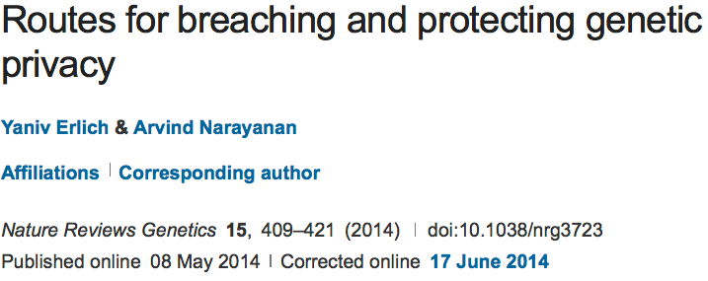
Genetic Privacy
CyberDNA, 10/8/15

Slide 3
Genetic Privacy
Breaching genetic privacy techniques: identity or trait attacks by aggregating data such as genotypes, GWAS statistics, DNA sequences, and metadata.

Slide 4
Infringement of Genetic Privacy
Identity attack
  Personal identifiable information
Trait attack
  Trait information associated with genomic
  information (e.g. genotypes/sequences)
CyberDNA, 10/8/15

Slide 5
Genetic Privacy Risks
Identity tracing attacks
Attribute disclosure attacks via DNA
Completion attacks

Slide 6
Identity Tracing attacks
The goal of identity tracing attacks is to uniquely identify an anonymous DNA sample using quasi-identifiers – residual pieces of information that are embedded in the dataset.
Searching with meta-data
Identity tracing by genealogical triangulation
Identity tracing by phenotypic prediction
Identity tracing by side-channel leaks

Slide 7
Searching with meta-data
Unrestricted demographic information conveys substantial power for identity tracing.
Health Insurance Portability and Accountability Act (HIPAA) Privacy rule
Pedigree structures contain rich information, especially when large kinships are available.
Another vulnerability of pedigrees is combining demographic quasi-identifiers across records to boost identity tracing despite HIPAA protections.

Slide 8
Identity tracing by genealogical triangulation
Genetic genealogy attracts millions of individuals interested in their ancestry or in discovering distant relatives.
One potential route of identity tracing is surname inference from Y-chromosome data
The main limitation of surname inference is that haplotype matching relies on comparing Y chromosome Short Tandem Repeats (Y-STRs).
An open research question is the utility of non Y chromosome markers for genealogical triangulation.

Slide 9
Identity tracing by phenotypic prediction
Predictions of visible phenotypes from genetic data could serve as quasi-identifiers for identity tracing.
Twin studies have estimated high heritabilities for various visible traits such as height and facial morphology.
Age prediction is possible from DNA specimens derived from blood samples.
But the applicability of these DNA-derived quasi-identifiers for identity tracing has yet to be demonstrated.

Slide 10
Identity tracing by side-channel leaks
Side-channel attacks exploit quasi-identifiers that are unintentionally encoded in the database building blocks and structure rather than the actual data that is meant to be public.
The mechanism to generate database accession numbers can also leak personal information

Slide 11
Attribute disclosure attacks via DNA (ADAD)
ADAD attack: The adversary gains access to the DNA sample of the target. He or she uses the identified DNA to search genetic databases with sensitive attributes. A match between the identified DNA and the database links the person and the attribute.
The simplest scenario
The summary statistic scenario
The gene expression scenario

Slide 12
ADAD: the simplest scenario
The adversary can simply match the genotype data that is associated with the identity of the individual and the genotype data that is associated with the attribute.
Such an attack requires only a small number of autosomal single nucleotide polymorphisms (SNPs).
ADAD is a theoretical vulnerability of virtually any individual level DNA-derived omics dataset such as RNA-seq and personal proteomics.
Genome-wide association studies (GWAS) are highly vulnerable to ADAD.

Slide 13
ADAD: the summary statistic scenario
With the target genotypes in the case group, the allele frequencies will be positively biased towards the target genotypes compared to the allele frequencies of the general population.
The actual risk of ADAD has been the subject of intense debate.

Slide 14
ADAD: the gene expression scenario
NIH’s Gene Expression Omnibus (GEO) publicly hold hundreds of thousands of gene expression profiles.
ADAD technique: The method starts with a training step that employs a standard expression quantitative trait loci (eQTL) analysis with a reference dataset. Next, the algorithm scans the public expression profiles. Last, the algorithm matches the target’s genotype with the inferred allelic distributions of each expression profile and tests the hypothesis that the match is random.
This ADAD technique has the potential for relatively high accuracy in ideal conditions.

Slide 15
Completion attacks
Genotype imputation: Jim Watson’s predisposition for Alzheimer’s disease from the ApoE locus despite masking of this gene
In the basic setting, the adversary obtains access to a single genetic dataset of a known individual. He then exploits this information to estimate genetic predispositions for relatives whose genetic information is inaccessible.
This attack is taking advantage of self-identified genetic datasets from OpenSNP.org

Slide 16
Completion attacks
In the advanced setting, the adversary has access to the genealogical and genetic information of multiple relatives of the target.
The algorithm finds relatives of the target that donated their DNA to the reference panel and that reside on a unique genealogical path that includes the target.

Slide 17
Ethics of genetic privacy and current regulations
Standards for Privacy of Individually Identifiable Health Information in the Health Insurance Portability and Accountability Act of 1996 (HIPAA).
The Privacy Rule was established to address the use and disclosure of individuals’ health information by covered entities, and provides standards for individual privacy rights to understand and control the use of their health information.
Many large human genome projects provide ethics education

Slide 18
Ethics and HIPAA Review
Key to advancing genetics diagnosis research
Private personal health information can be protected
Discrimination/Bias based on released heath information can be eliminated (minimized)
HIPAA Privacy Rule: All federal grants with human subjects involved should be protected by HIPAA

Slide 19
Introduction to HIPAA
The Standards for Privacy of Individually Identifiable Health Information (“Privacy Rule”) establishes, for the first time, a set of national standards for the protection of =certain health information.
The U.S. Department of Health and Human Services (“HHS”) issued the Privacy Rule to implement the requirement of the Health Insurance Portability and Accountability Act of 1996 (“HIPAA”).
The Privacy Rule standards address the use and disclosure of individuals’ health information—called “protected health information” by organizations subject to the Privacy Rule — called “covered entities,” as well as standards for individuals' privacy rights to understand and control how their health information is used.
Within HHS, the Office for Civil Rights (“OCR”) has responsibility for implementing and enforcing the Privacy Rule with respect to voluntary compliance activities and civil money penalties.

Slide 20
Information Protected by HIPAA
Protected Health Information
  The Privacy Rule protects all “individually identifiable health information”
  only covers patient information kept by health providers, insurers and data clearinghouses, as well as their business partners
De-Identified Health Information.
  There are no restrictions on the use or disclosure of de-identified health information.

Slide 21
Information NOT Protected by HIPPA
De-identified health information
Medical information not originated from entities not covered by HIPAA (e.g. 23andMe, genetic screening companies)
Consumer-generated health information (home paternity tests, fitness trackers, health apps, social media)
Personal information (ethic, identity, etc.) inferred from de-identified health information
Meta data such as age, geographical regions, races of participants

Slide 22
HIPAA Safe Harbor Rule
Dissemination of demographic identifiers has been the subject of tight regulation in the US health care system.
The maximal resolution of any date field, such as hospital admission dates, is in years.
The maximal resolution of a geographical subdivision is the first three digits of a zip code (for zip code areas with populations of >20,000).
CyberDNA, 10/8/15
Notes:
A standard in the HIPAA rule for de-identification of protected health information by removing 18 bytes of quasi-identifiers (residual pieces of information embedded in the data set).

Slide 23

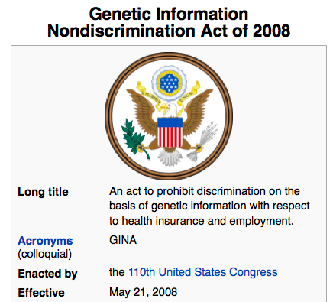
GINA
CyberDNA, 10/8/15

Slide 24
Genetic Privacy
De-identification is insufficient to protect identity
Homer N, et al. Plos Genetics, 2008
  Suggest that composite statistics across cohorts, such as allele frequency or genotype counts, do not mask identity within genome-wide association studies.
Aggregate data can be harmful as far as privacy is concerned.
The genotype-phenotype data (dbGaP) at NIH is controlled access.

Slide 25
Genetic Privacy
Gymrek M, et al. Science, 2013
  Use the 1000 Genomes Project Phase 1 data with whole genome sequences of 1,092 individuals (no phenotypes so publicly accessible)
  Surnames can be recovered from personal genomes by profiling short tandem repeats on the Y chromosome (Y-STRs) and querying recreational genetic genealogy databases.
  A combination of a surname with other types of metadata, such as age and state, can be used to triangulate the identity of the target.
  Age information is taken out from the publicly accessible 1000 Genomes Project data.
S.S. Shringarpure and C.D. Bustamante, “Privacy leaks from genomic data-sharing beacons,” The American Journal of Human Genetics, 97: 1-15, 2015.

Slide 26

HIPAA Breaches
More than 41 million people have had their protected health information compromised in HIPAA privacy and security breaches.

Slide 27
NIH Policy and Ethics Issues
Coverage and Reimbursement of Genetic Tests
Genetic Discrimination
Informed Consent for Genomic Research
Intellectual Property
Privacy in Genomics
Regulation of Genetic Tests

Slide 28
Coverage and Reimbursement of Genetic Tests
Genomic medicine has the capacity to revolutionize clinical practice.
One challenge insurers face is the difficulty of deciding when to reimburse for genetic tests that health care providers have offered their patients.
Payers are having trouble keeping up with the volume of new genetic and next-generation sequencing tests that are coming onto the market.
https://www.genome.gov/19016729/coverage-and-reimbursement-of-genetic-tests/

Slide 29
Genetic Discrimination
Many Americans fear that participating in research or undergoing genetic testing will lead to being discriminated against based on their genetics.
The Genetic Information Nondiscrimination Act (GINA) was passed into law, prohibiting discrimination by employers and health insurers.
There are also other legal protections against genetic discrimination by employers, health insurers, and others.
https://www.genome.gov/10002077/genetic-discrimination/

Slide 30
Informed Consent for Genomic Research
Advances in genomic technology and analytical tools are enabling discoveries that enhance our understanding of the impact of genomic variants on health and disease.
Informed consent shows respect for personal autonomy and is an important ethical requirement in research. (HIPAA Privacy Rule)
Informed consent involves two fundamental components: a dialogue or process, and a form.
https://www.genome.gov/27026588/informed-consent-for-genomics-research/

Slide 31
Intellectual Property
In a landmark decision in June 2013, the Supreme Court determined that DNA in its natural form cannot be patented.
The National Human Genome Research Institute (NHGRI) to research "legal issues regarding patents" as part of the then center's research into the ethical, social, and legal implications of human genome research.
The Courts and Gene Patents
https://www.genome.gov/19016590/intellectual-property/

Slide 32
Privacy in Genomics
Each person's DNA sequence includes health and other information about them and their families.
Usage and privacy need to be balanced.
Genetic Information Nondiscrimination Act (GINA)
The HIPAA Privacy Rule
Certificates of Confidentiality
The Freedom of Information Act (FOIA)
NIH Genomic Data Sharing Policy
https://www.genome.gov/27561246/privacy-in-genomics/

Slide 33
Regulation of Genetic Tests
Genetic tests focus on an individual's inheritance of a single gene, while genomic tests look at an individual's wider inheritance of various genetic traits.
Analytical Validity
Clinical Validity
Clinical Utility
CMS Regulation: Clinical Laboratory Improvement Amendments (CLIA)
FDA Regulation
https://www.genome.gov/10002335/regulation-of-genetic-tests/

Slide 34
References
Shi, Xinghua, and Xintao Wu. "An overview of human genetic privacy." Annals of the New York Academy of Sciences 1387.1 (2017): 61-72.
Erlich, Yaniv, and Arvind Narayanan. "Routes for breaching and protecting genetic privacy." Nature Reviews Genetics 15.6 (2014): 409.

